Slide 1
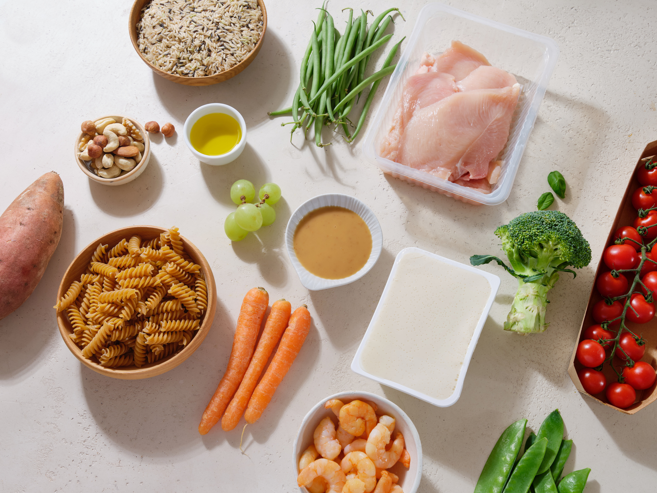
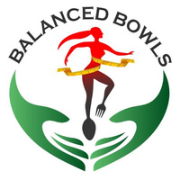

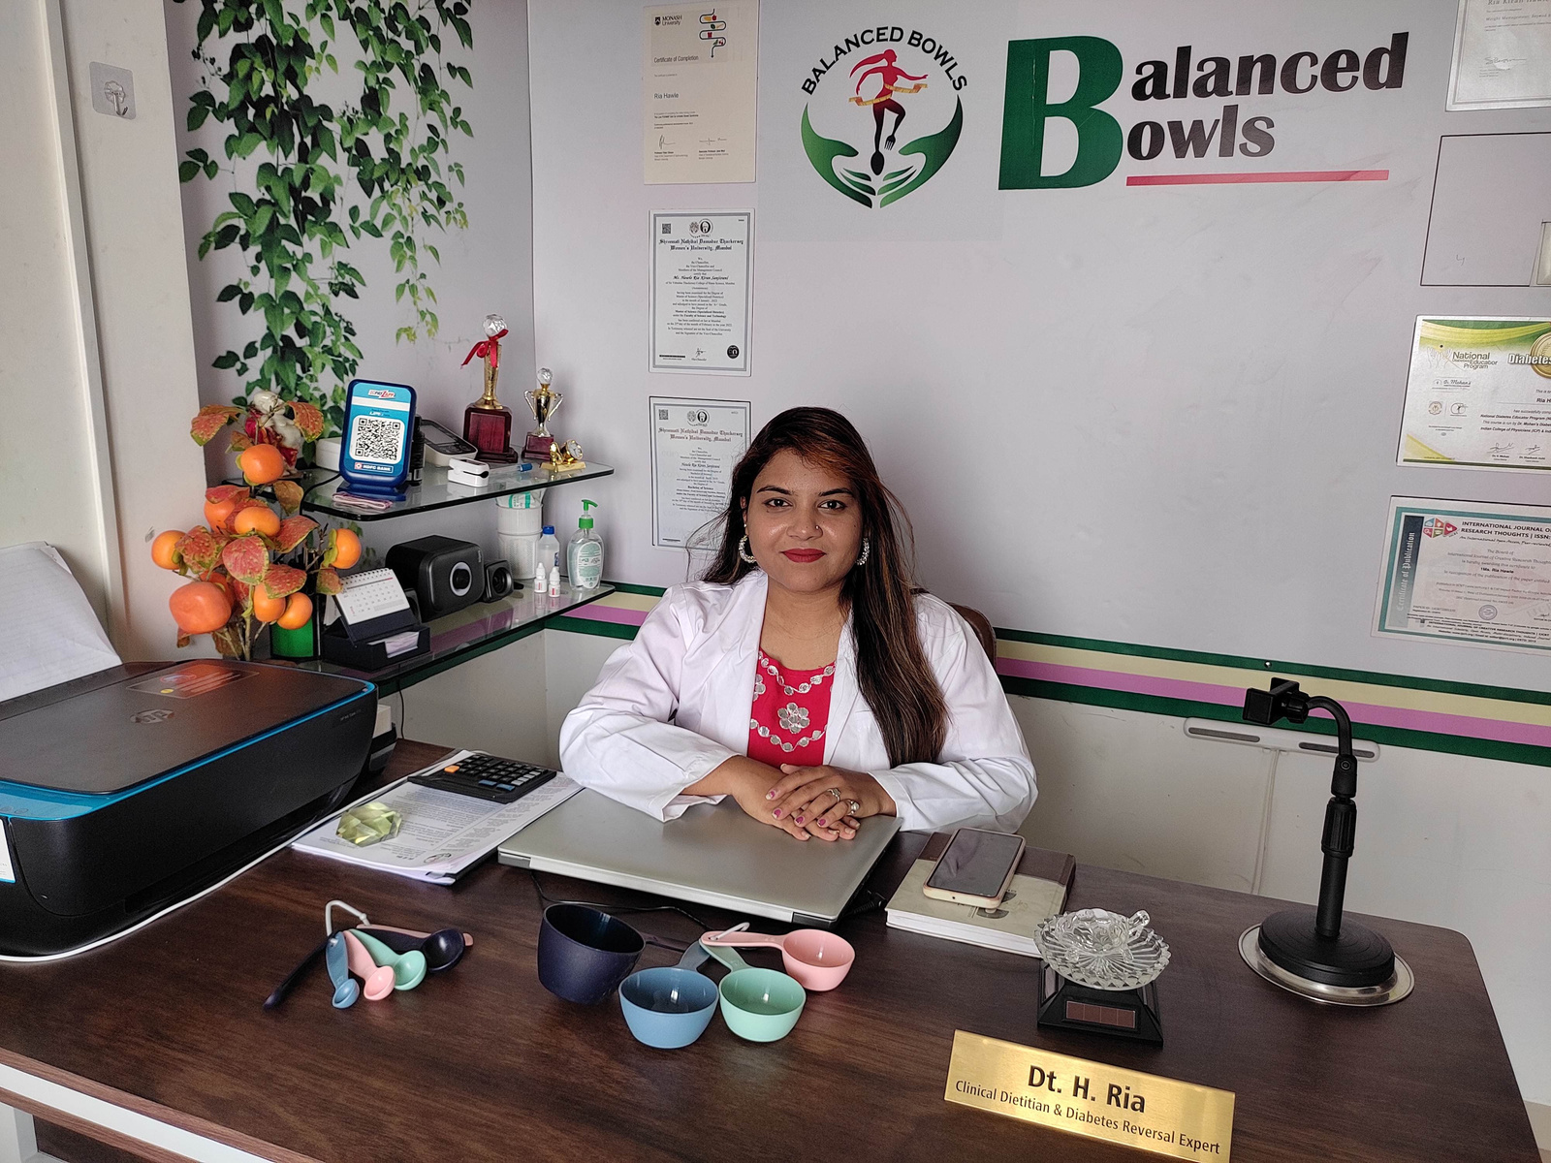

Balanced Diet - The Key to Healthy Living
by Best Dietitian in Pune - Dt. Ria Hawle
Visit
https://balancedbowls.in

Slide 2
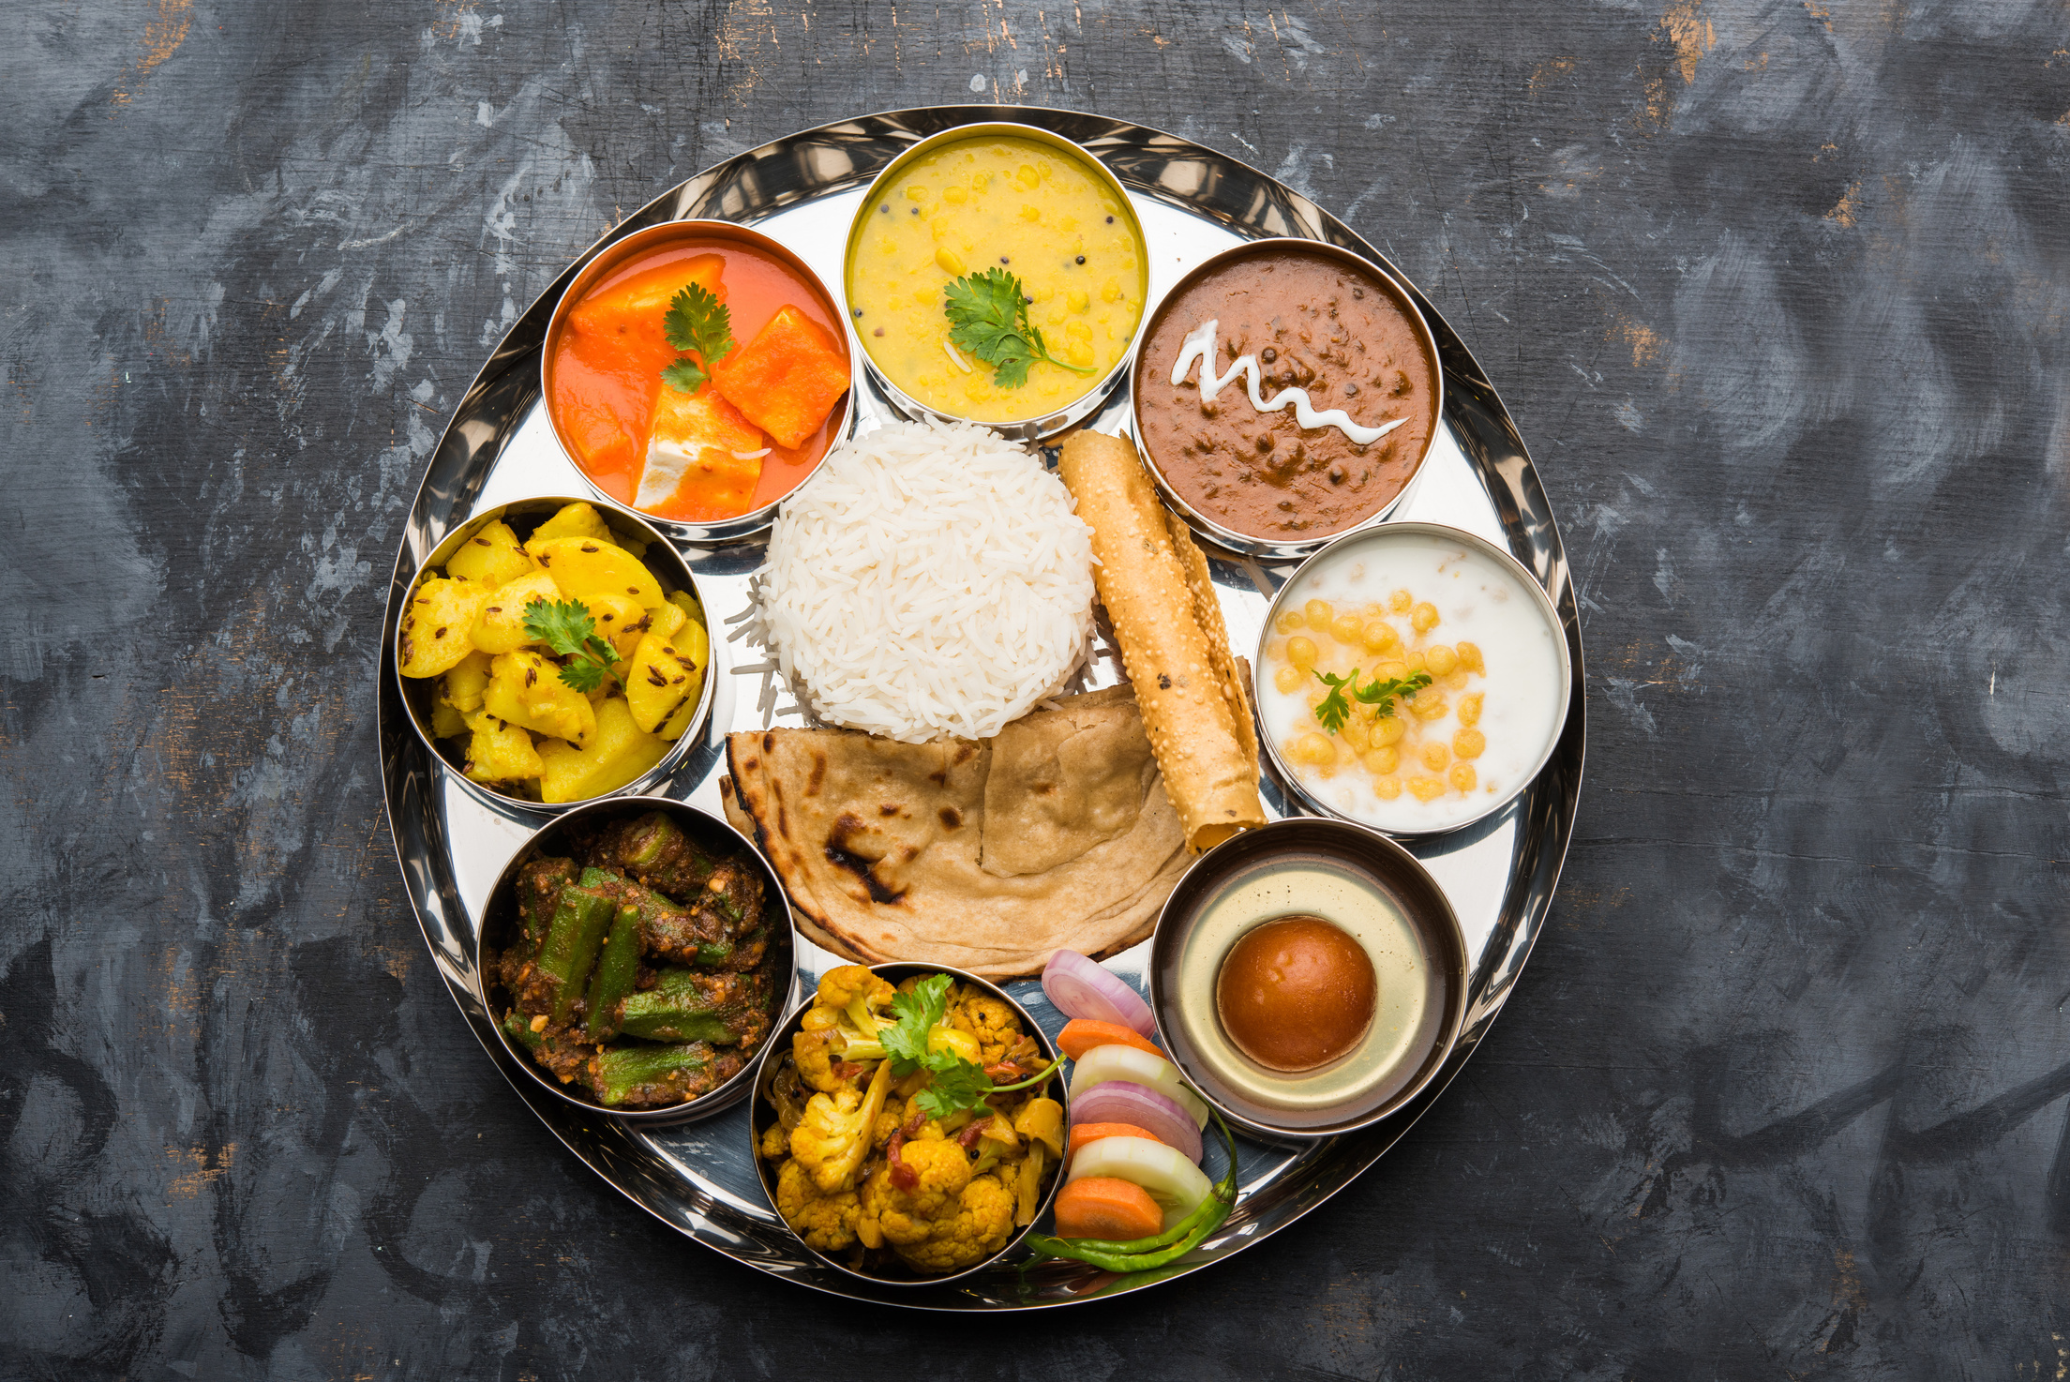

What is a Balanced Diet?
A balanced diet is a meal plan that provides the right amount of nutrients, energy, and hydration required for overall well-being.
It includes the correct proportions of carbohydrates, proteins, fats, vitamins, minerals, and fiber.
Example - Indian balanced diet includes roti, dal, rice, vegetables, curd, and fruits for a wholesome meal.

Slide 3
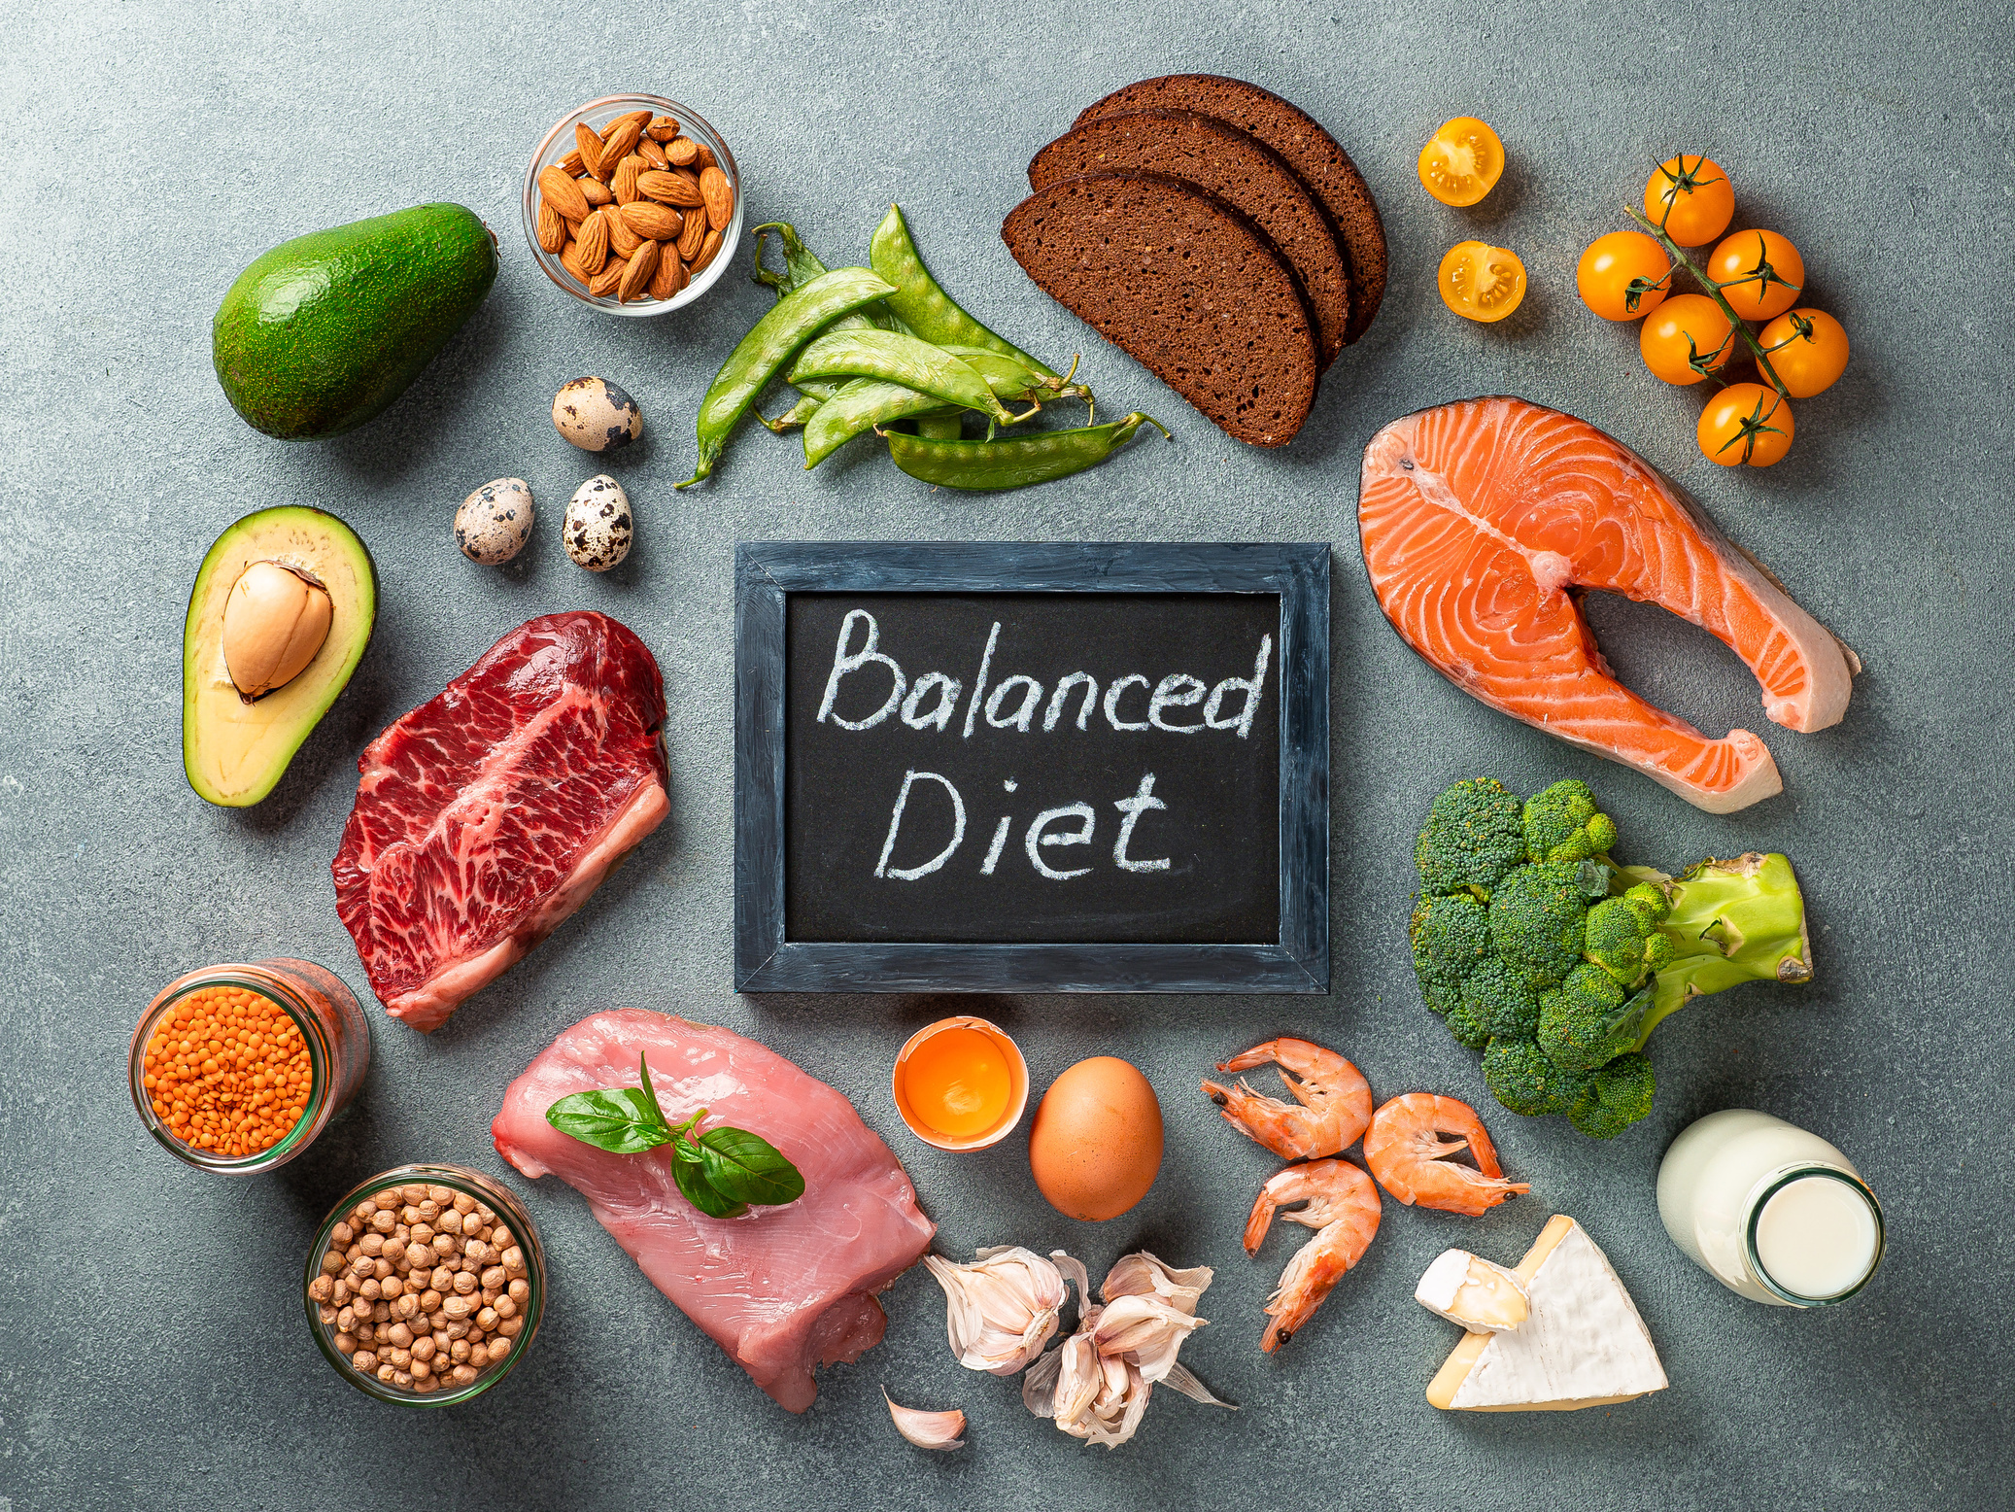
Balanced Diet Formal Definition
“A balanced diet is a diet that contains different types of foods in certain quantities and proportions to meet the body’s needs.”
- WHO (World Health Organization)

Slide 4
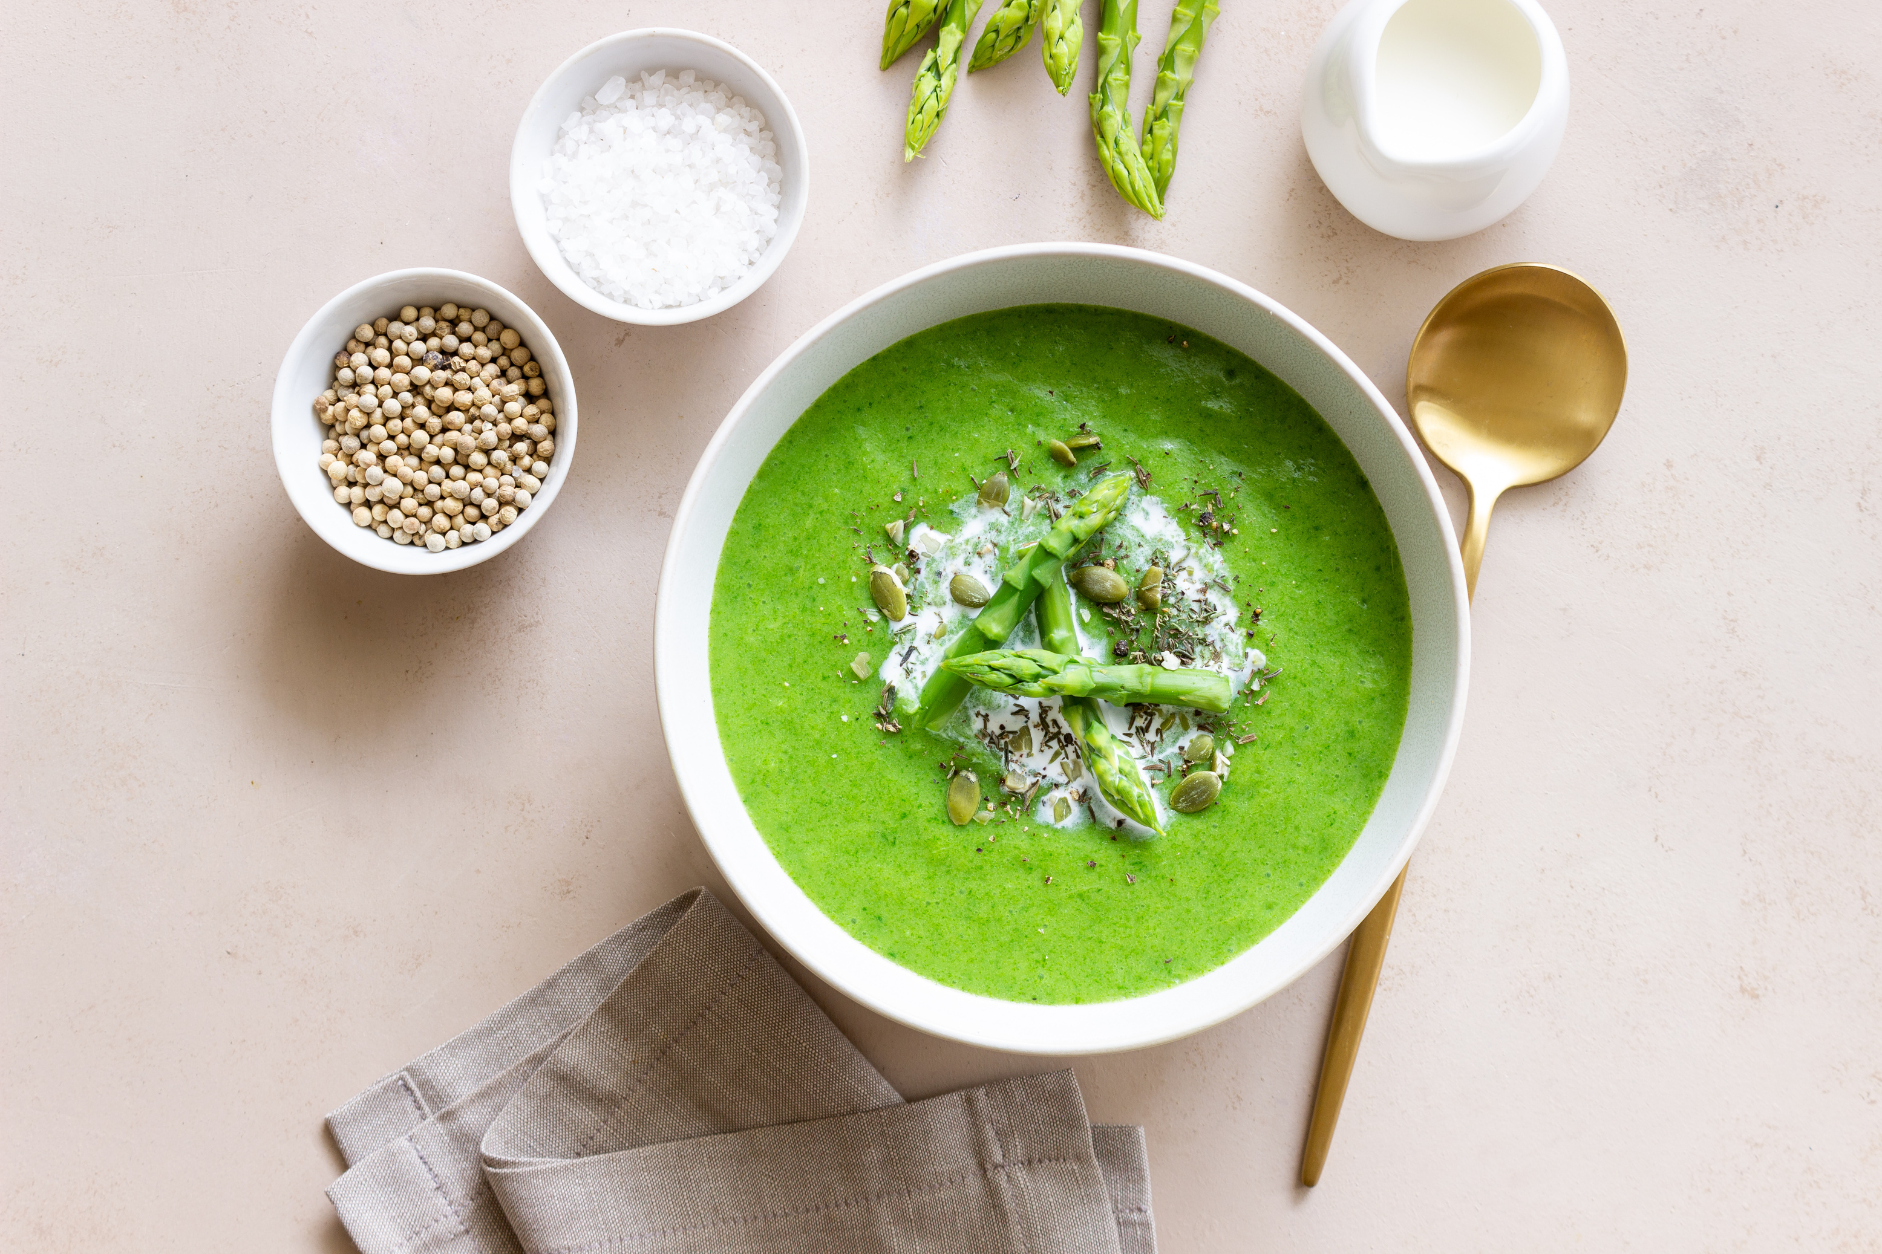
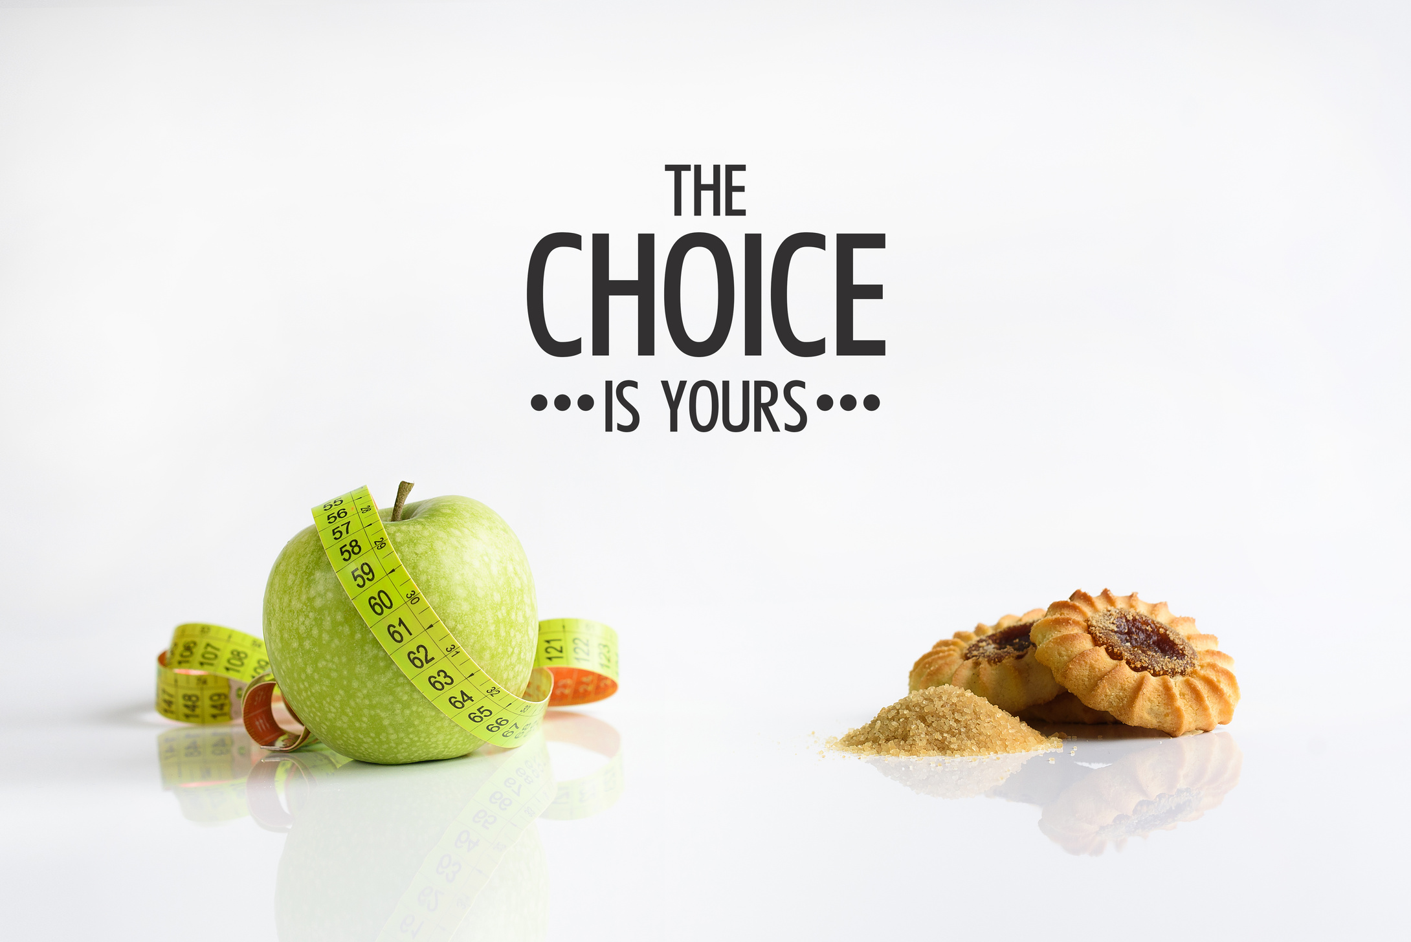
Importance of a Balanced Diet
✔ Boosts immunity and prevents diseases
✔ Maintains healthy weight and metabolism
✔ Supports growth and development (important for children & teenagers)
✔ Improves digestion and gut health
✔ Enhances energy levels and brain function

Slide 5
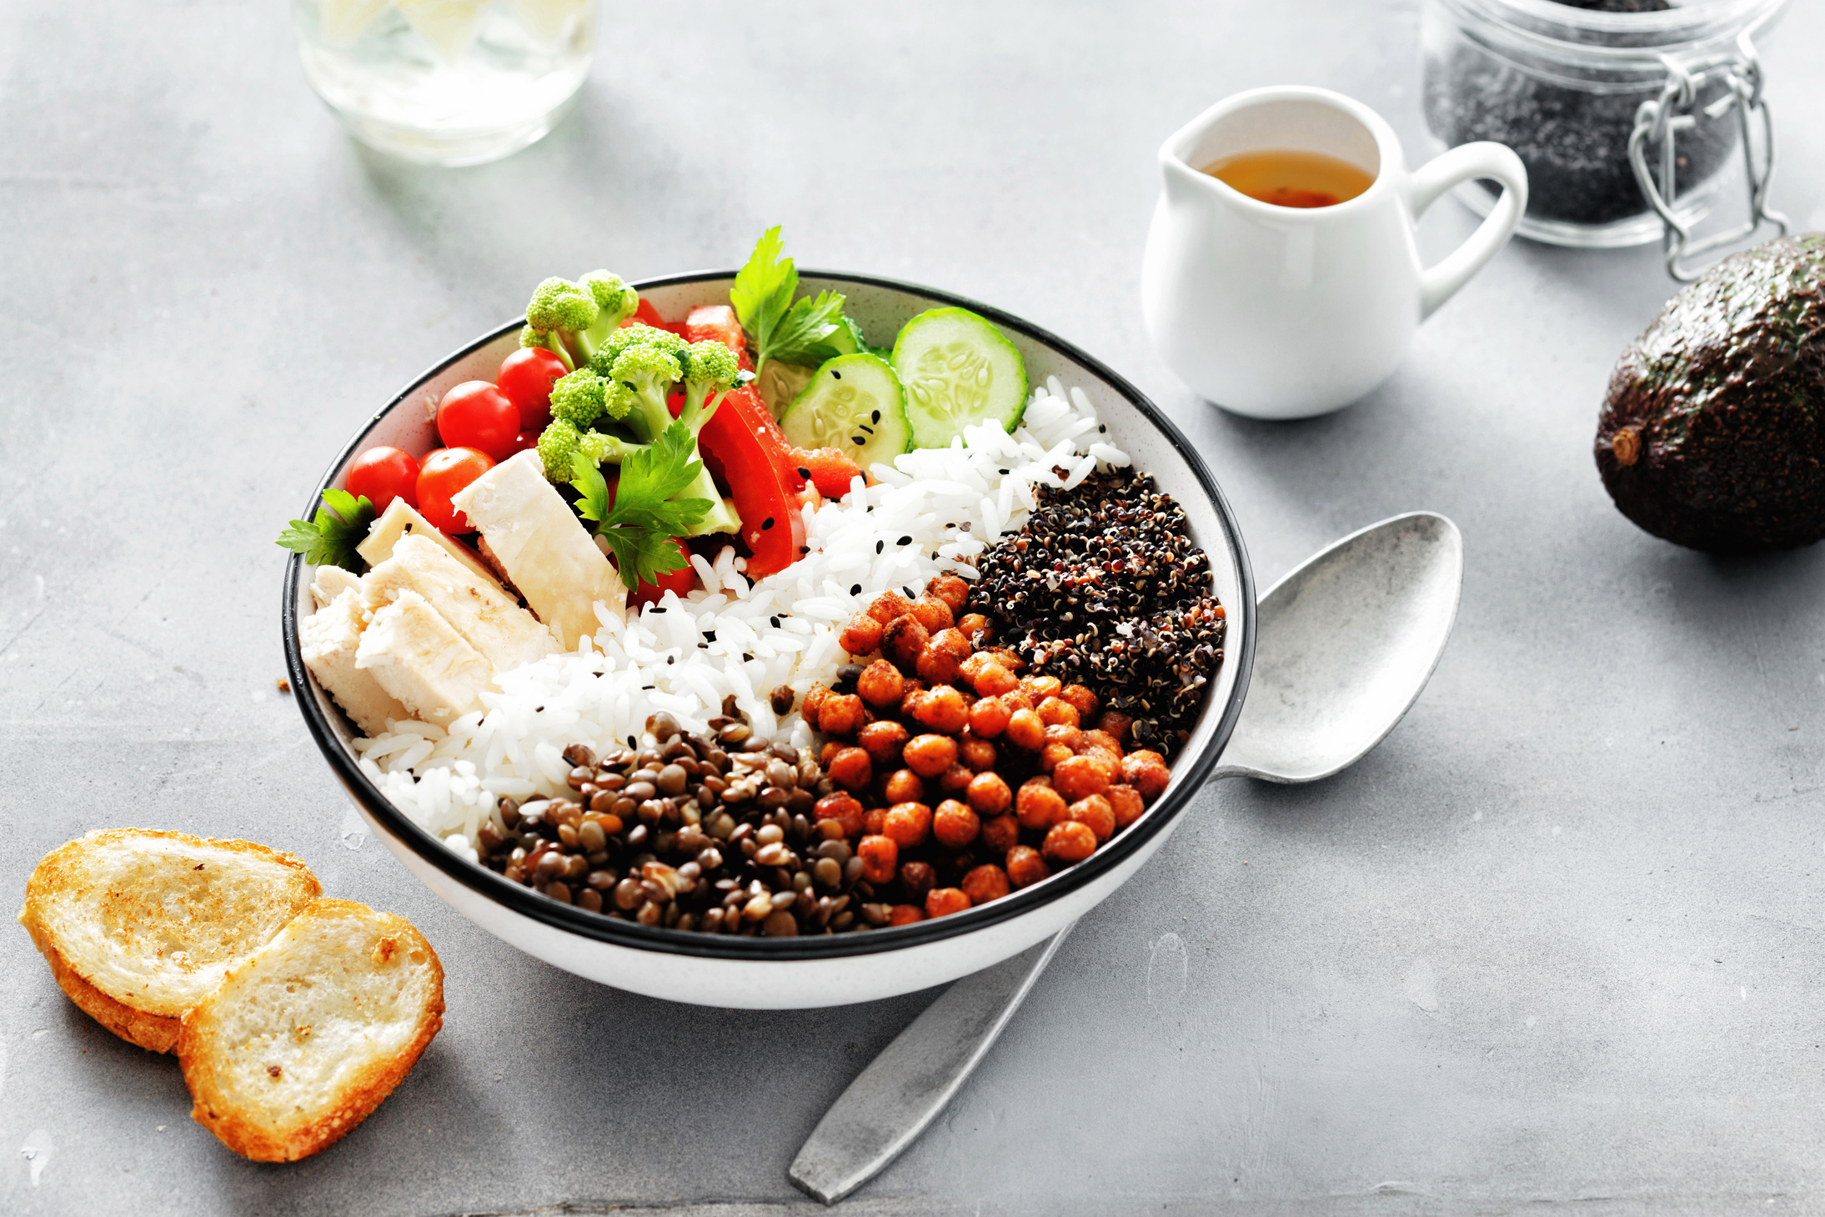
Components of a Balanced Diet
6 Essential Nutrients Required:
  Carbohydrates (Rice, chapati, bread, potatoes) – Energy providers
  Proteins (Dal, paneer, eggs, fish, tofu) – Growth & muscle repair
  Fats (Nuts, seeds, ghee, olive oil) – Brain & heart health
  Vitamins & Minerals (Fruits, vegetables, dairy) – Immunity & overall health
  Water (Hydration, detoxification) – Essential for all body functions
  Fiber (Whole grains, fruits, leafy vegetables) – Digestion & gut health

Slide 6
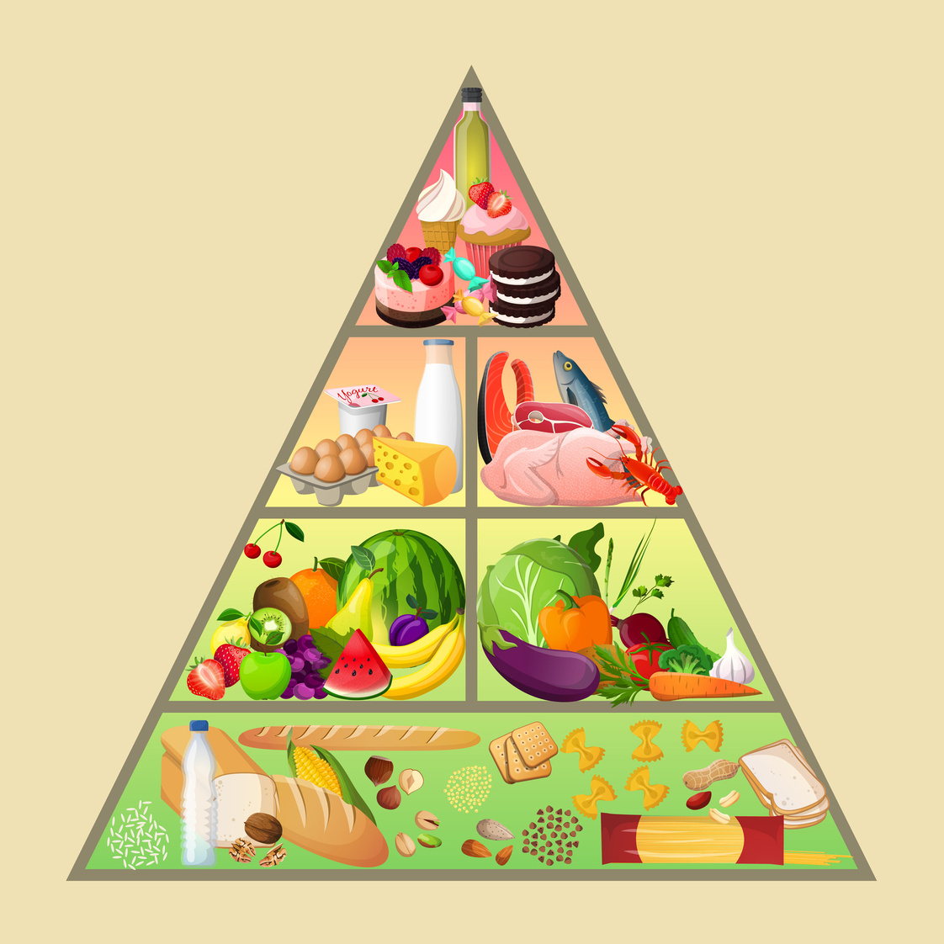
Balanced Diet Pyramid
  Top Layer (Fats & Sweets) – Consume sparingly
  Proteins & Dairy – Essential for muscle building
  Fruits & Vegetables – Rich in vitamins & minerals
  Grains & Carbohydrates – Energy source

Slide 7
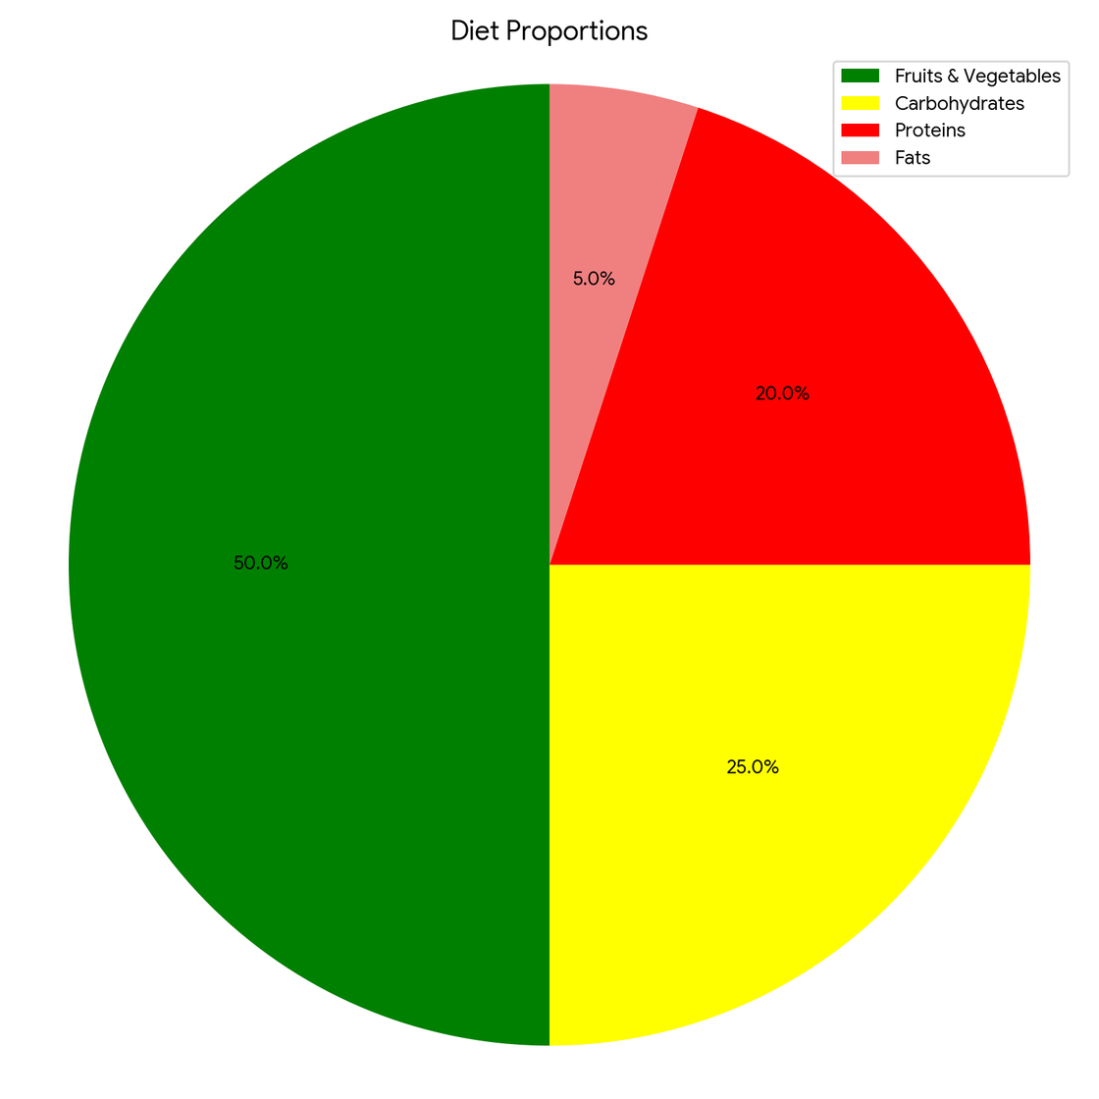
Balanced Diet Pie Chart
What Should Your Plate Look Like?
50% – Fruits & Vegetables
25% – Proteins (Pulses, Meat, Dairy) + fats
25% – Whole Grains (Rice, Roti, Bread)

Slide 8
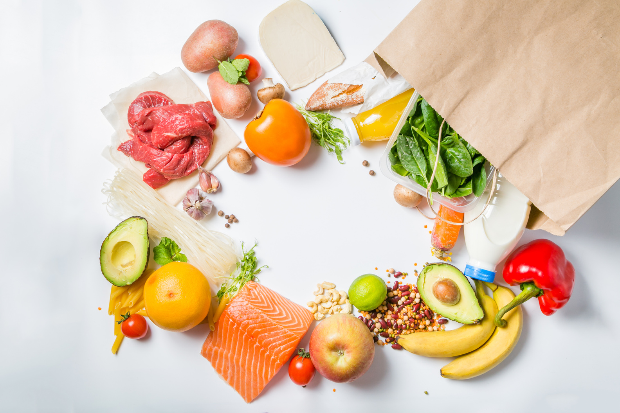
Daily Routine Balanced Diet Chart
Example of a Daily Indian Balanced Diet Plan
🍽 Breakfast – Poha with nuts, banana, and milk
🍽 Lunch – Roti, dal, sabzi, salad, buttermilk
🍽 Snack – Sprouts chaat or fruit bowl
🍽 Dinner – Light khichdi or grilled paneer with vegetables

Slide 9
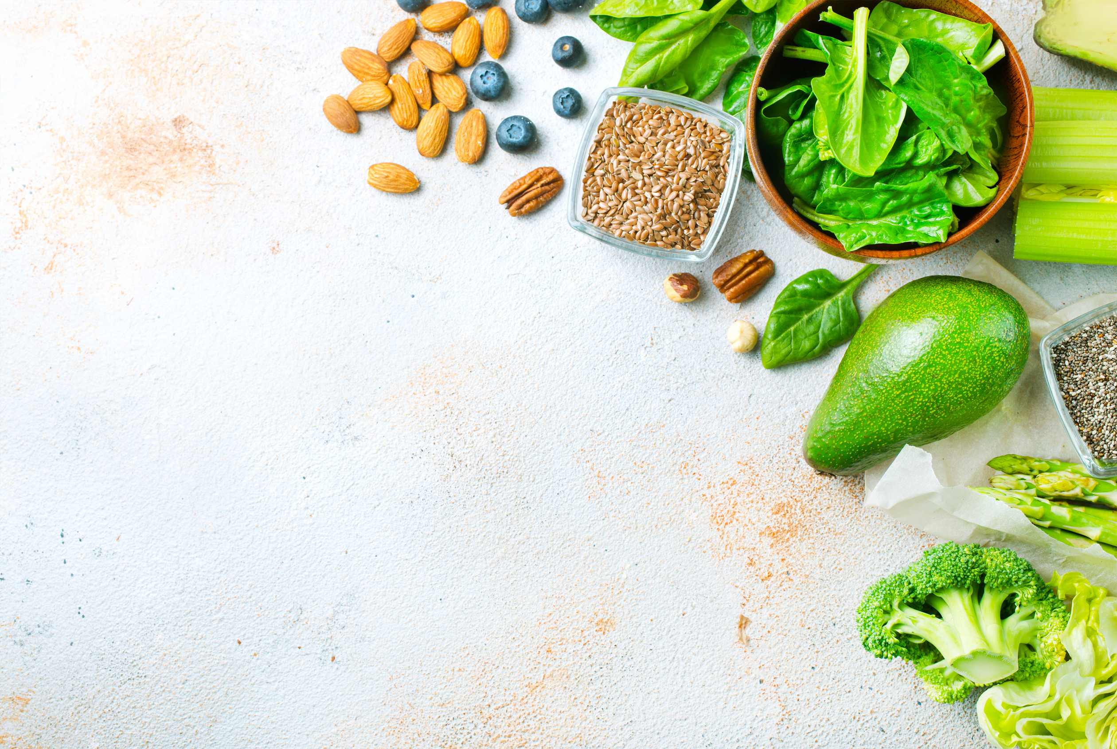
Principles of a Balanced Diet
✔ Eat a variety of nutrient-rich foods
✔ Maintain portion control
✔ Stay hydrated
✔ Avoid processed and junk foods
✔ Balance macronutrients and micronutrients

Slide 10
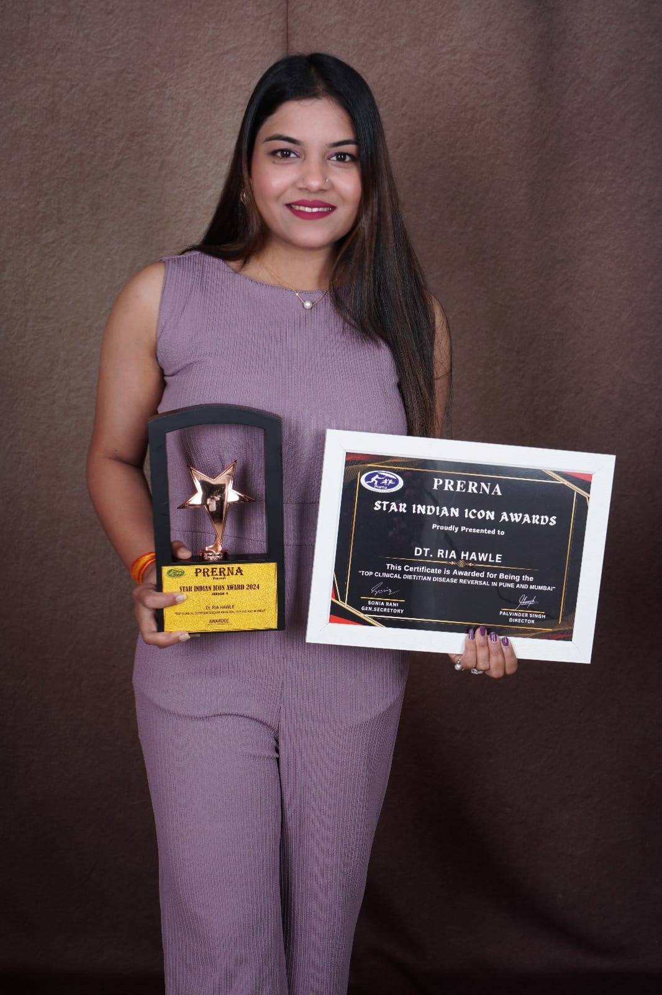



About Balanced Bowls, Pune
by Best Dietitian in Pune - Dt. Ria Hawle
Balanced Bowls Pune offers nutrient-rich, wholesome meal plans curated for a healthy and balanced lifestyle.
Our meals focus on fresh, high-quality ingredients, ensuring optimal nutrition for weight management, fitness goals, and overall well-being.
Perfect for those seeking delicious yet healthy eating options in Pune
+91-8208307124
https://balancedbowls.in
riabalancedbowls@gmail.com

