Slide 1
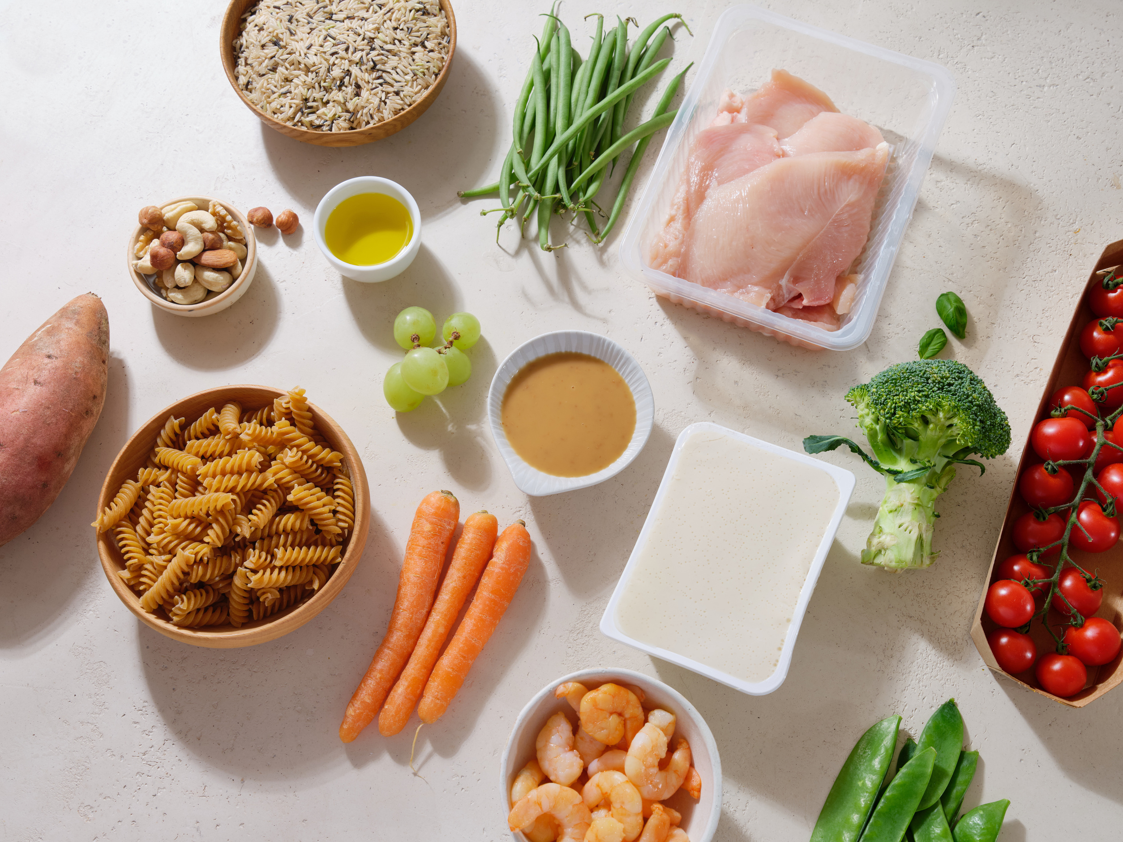
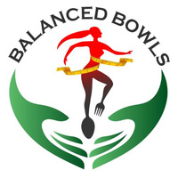

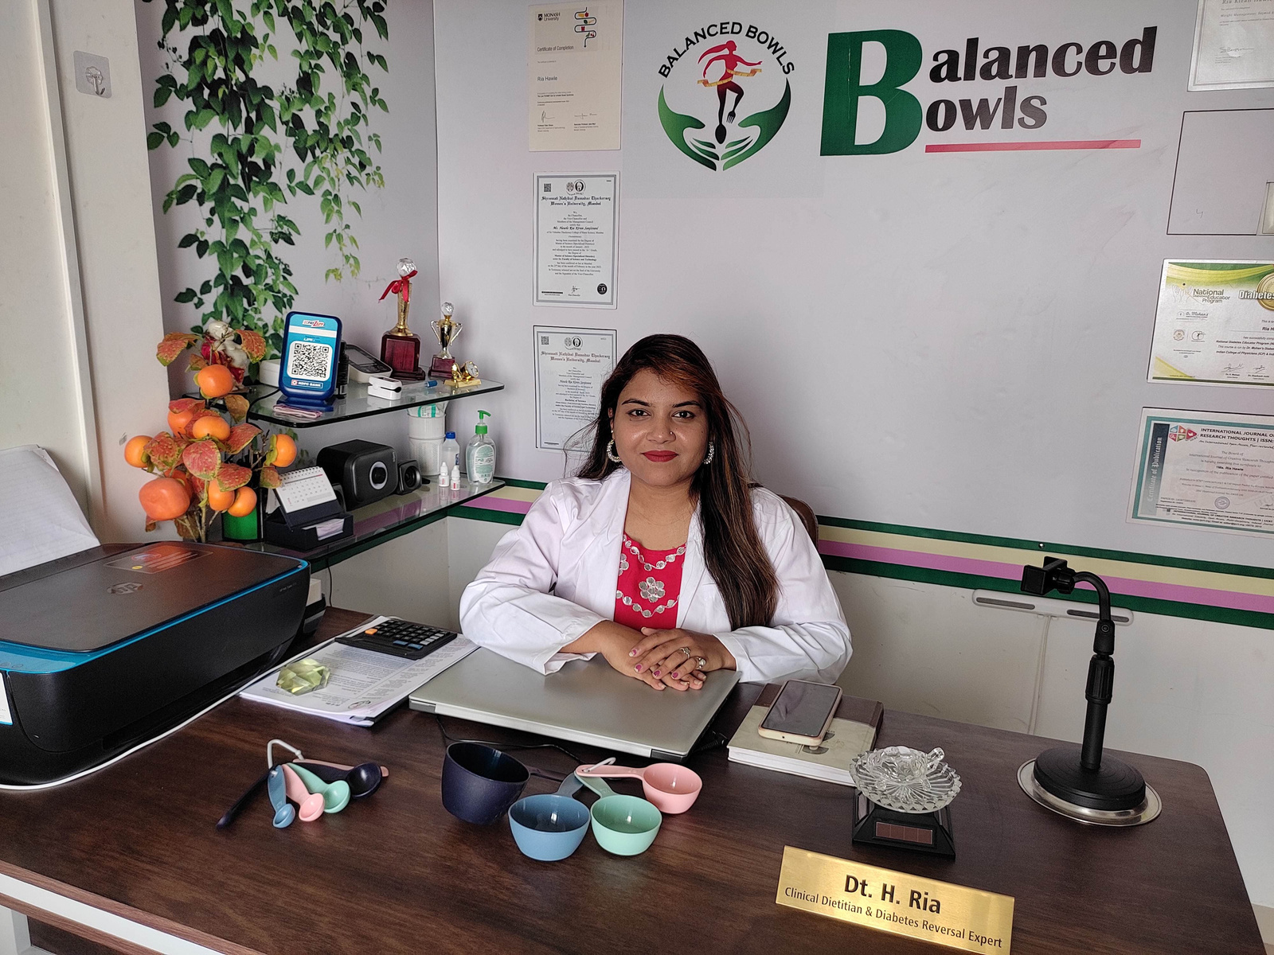

Antenatal Diet PPT
by Best Dietitian in Pune - Dt. Ria Hawle
Visit
https://balancedbowls.in

Slide 2


Introduction
The antenatal diet plays a crucial role in fetal development, maternal health, and a smooth pregnancy journey.
A well-balanced diet ensures that the mother and baby receive essential nutrients, reducing complications like gestational diabetes, low birth weight, and neural tube defects.

Slide 3
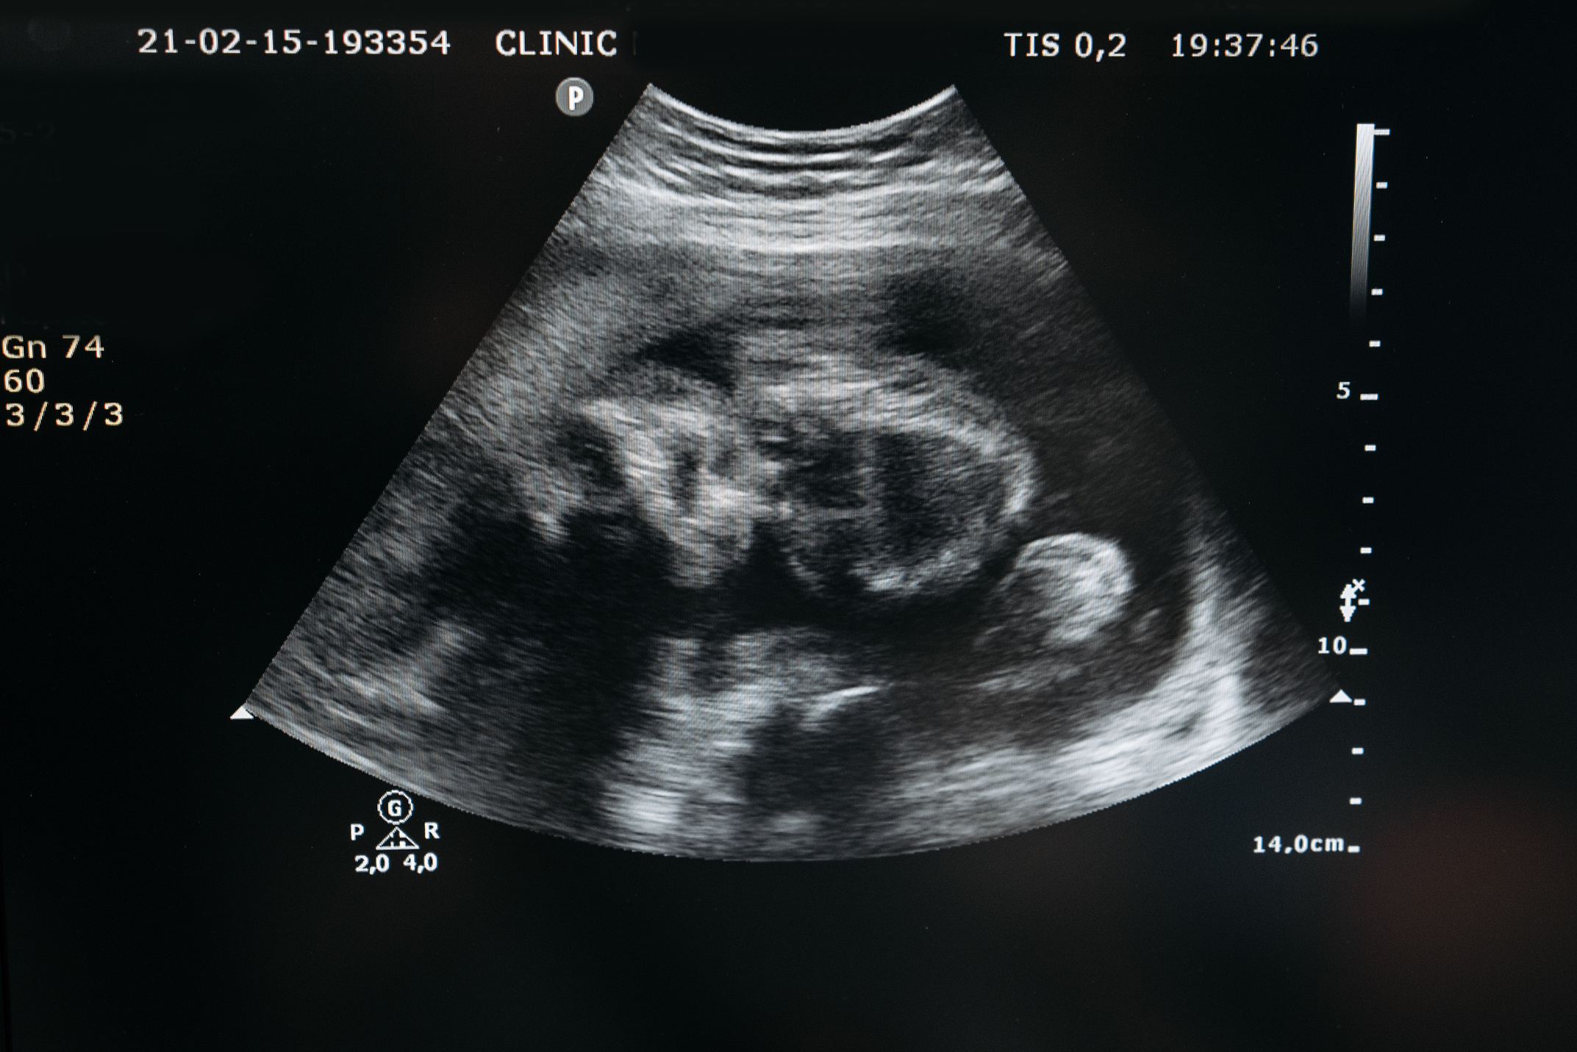
Definition of Antenatal Diet
An antenatal diet refers to the nutritional intake during pregnancy that supports the mother’s changing needs and the baby’s development.
It includes macronutrients (carbohydrates, proteins, fats), micronutrients (vitamins & minerals), and hydration.
Balanced nutrition reduces the risk of pregnancy complications, birth defects, and preterm labor.

Slide 4
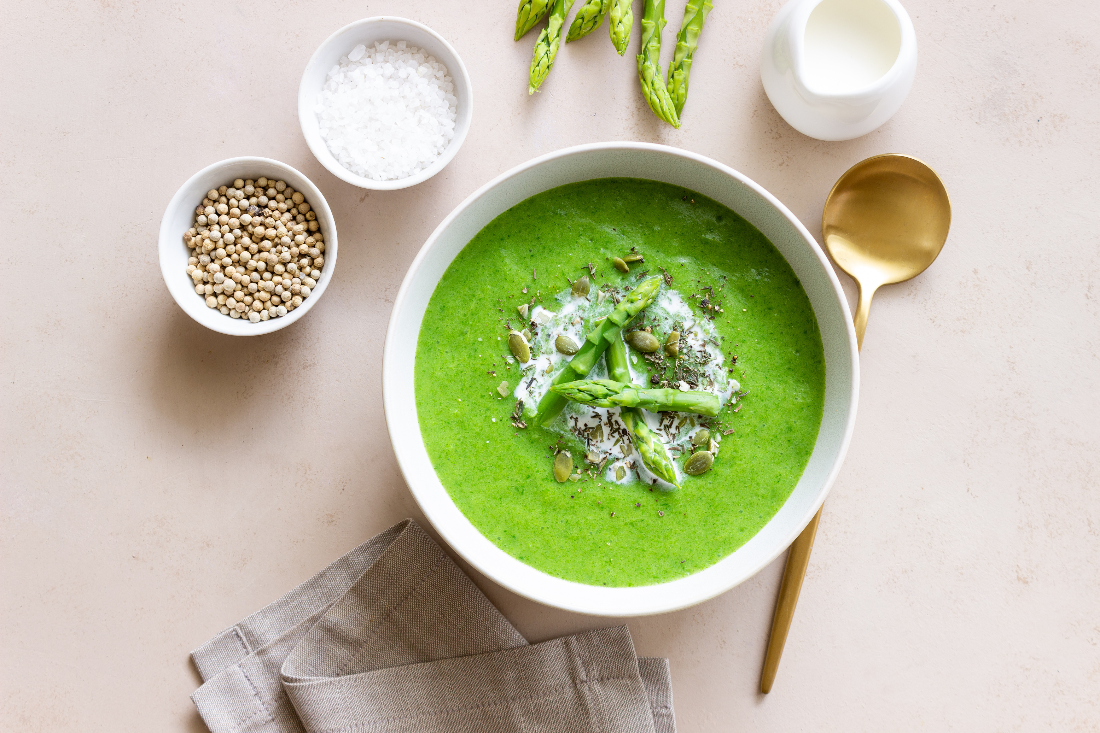
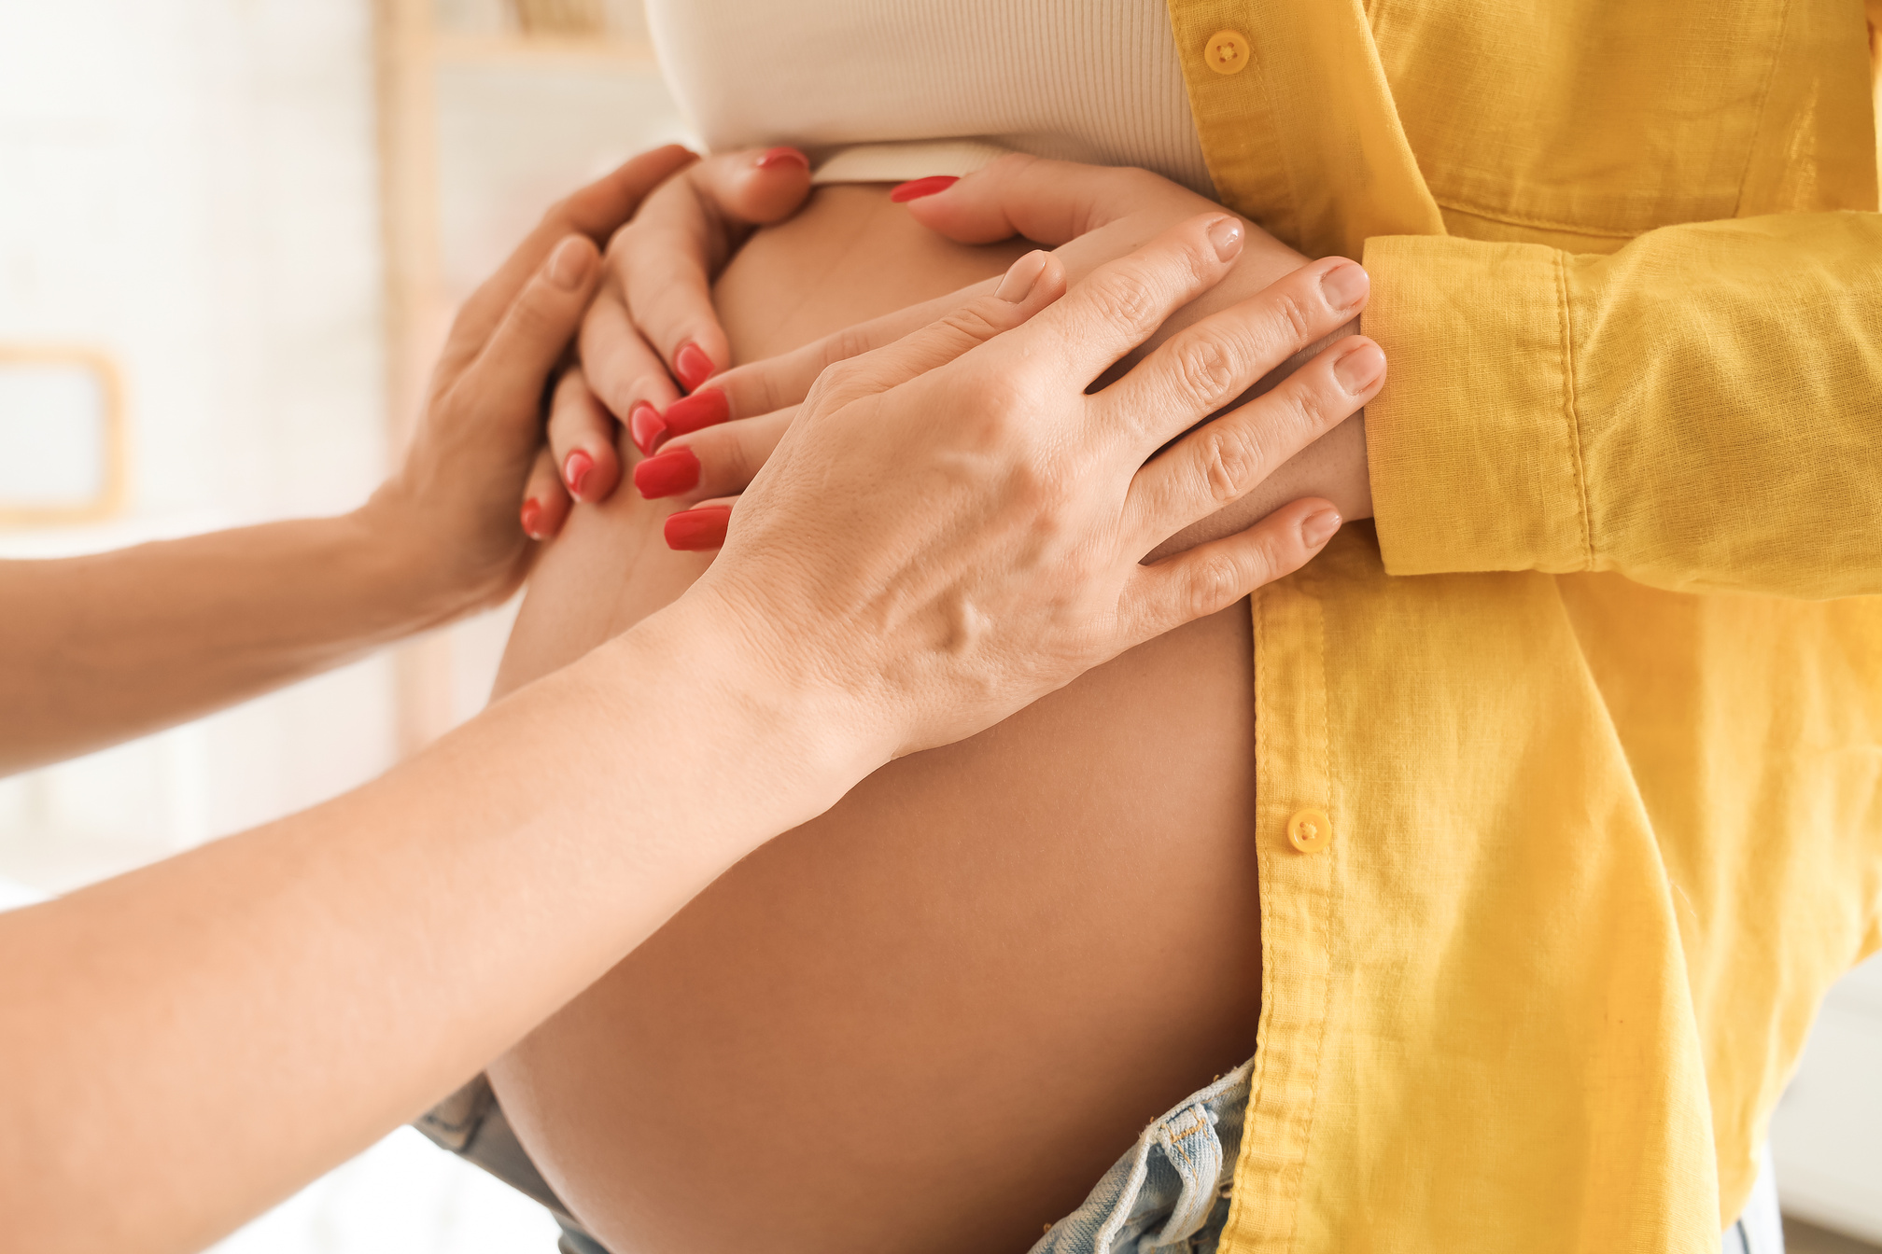
Objectives of Antenatal Diet
  Ensure Fetal Growth & Development: Adequate protein, folic acid, and iron support healthy brain and body formation.
  Maintain Maternal Health: Prevents gestational diabetes, anemia, and preeclampsia.
  Support Weight Gain: Healthy weight gain (10-15 kg) is crucial for fetal nourishment.
  Boost Immunity & Reduce Risk Factors: Omega-3, Vitamin C, and Zinc enhance immune function and reduce complications.
  Prepare for Labor & Postpartum Recovery: Protein and calcium strengthen muscles and bones, aiding delivery and postnatal healing

Slide 5
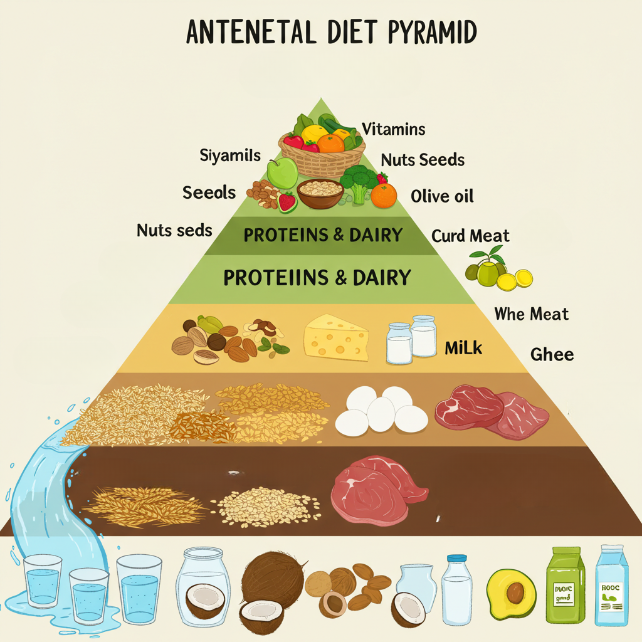
Antenatal Diet Pyramid
  Base (Hydration): 8-10 glasses of water, coconut water, fresh juices
  Whole Grains & Fiber: Brown rice, oats, whole wheat, millets
  Proteins & Dairy: Paneer, tofu, eggs, lean meat, curd, milk
  Healthy Fats: Nuts, seeds, olive oil, ghee
  Vitamins & Minerals: Fruits (bananas, oranges, berries), vegetables (spinach, broccoli, carrots)
Whole grain foods

Slide 6
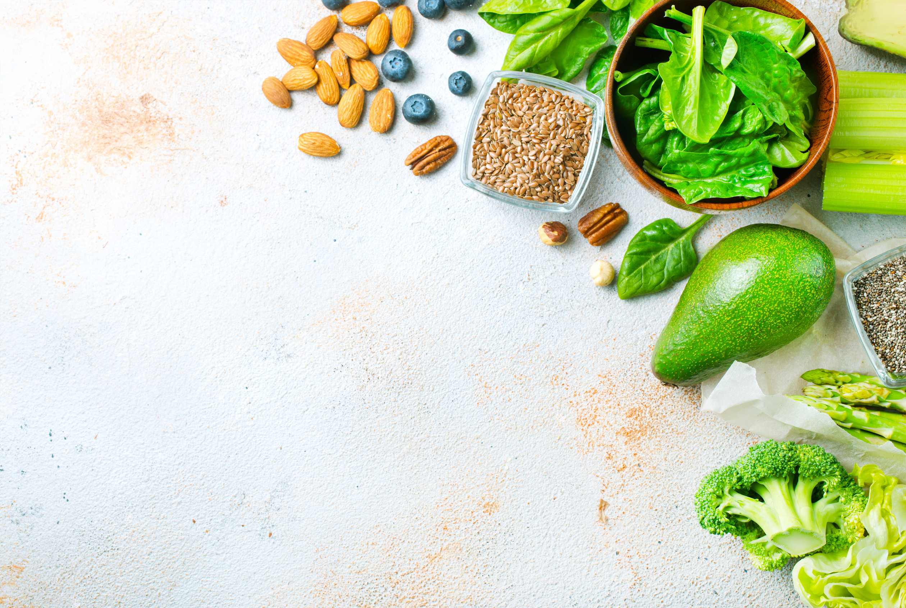
Antenatal Diet Menu Plan (Sample Day)
Breakfast
Mid-Morning Snack
Lunch
Oats porridge with nuts & banana + herbal tea
Greek yogurt with chia seeds & honey
Multigrain roti + dal + sabzi (spinach, carrot) + salad
Evening Snack
Dinner
Bedtime Snack
Roasted makhana & coconut water
Grilled fish/tofu + brown rice + steamed veggies
Warm milk with saffron & almonds

Slide 7
Antenatal Diet Chart for Indian Women
Iron-Rich Foods
Folic Acid Sources
Calcium Intake
Spinach, beetroot, pomegranate, dates
Lentils, citrus fruits, leafy greens
Milk, ragi, sesame seeds
Protein Choices
Hydration
Paneer, eggs, fish, soya
8-10 glasses of water, coconut water, buttermilk

Slide 8

Prenatal Diet and Autism
Research suggests that a nutrient-rich prenatal diet (high in Omega-3, folate, and Vitamin D) may reduce the risk of autism spectrum disorder (ASD).
Key foods: Fatty fish, eggs, nuts, leafy greens, fortified dairy products
Avoid: Processed foods, artificial sweeteners, and excessive sugar intake

Slide 9


Prenatal Diet for Baby Boy
Myth
Eating more dairy and protein ensures a baby boy.
Fact
While some studies suggest higher-calorie diets might favor male births, there is no scientific guarantee.
Key nutrients: Zinc, folic acid, and healthy fats improve reproductive health.
Focus on nutrient-rich foods for optimal fetal development, rather than trying to influence gender through diet.

Slide 10


Prenatal Vitamins and Low Carb Diet
Take the First Step Towards a Healthier You
Prenatal vitamins (Folic acid, Iron, DHA, Vitamin D) are essential regardless of carb intake.
A low-carb diet should be carefully planned to prevent deficiencies.
Focus on: Healthy carbs from fruits, whole grains, legumes, and dairy.

Slide 11
Prenatal Vitamins While Dieting
Pregnant women on weight-control diets must still take prenatal vitamins to prevent deficiencies
Essential vitamins: Iron, calcium, DHA, Vitamin B12, and iodine
Key foods for controlled weight gain: Protein-rich meals, fiber-rich vegetables, and healthy fats.

Slide 12
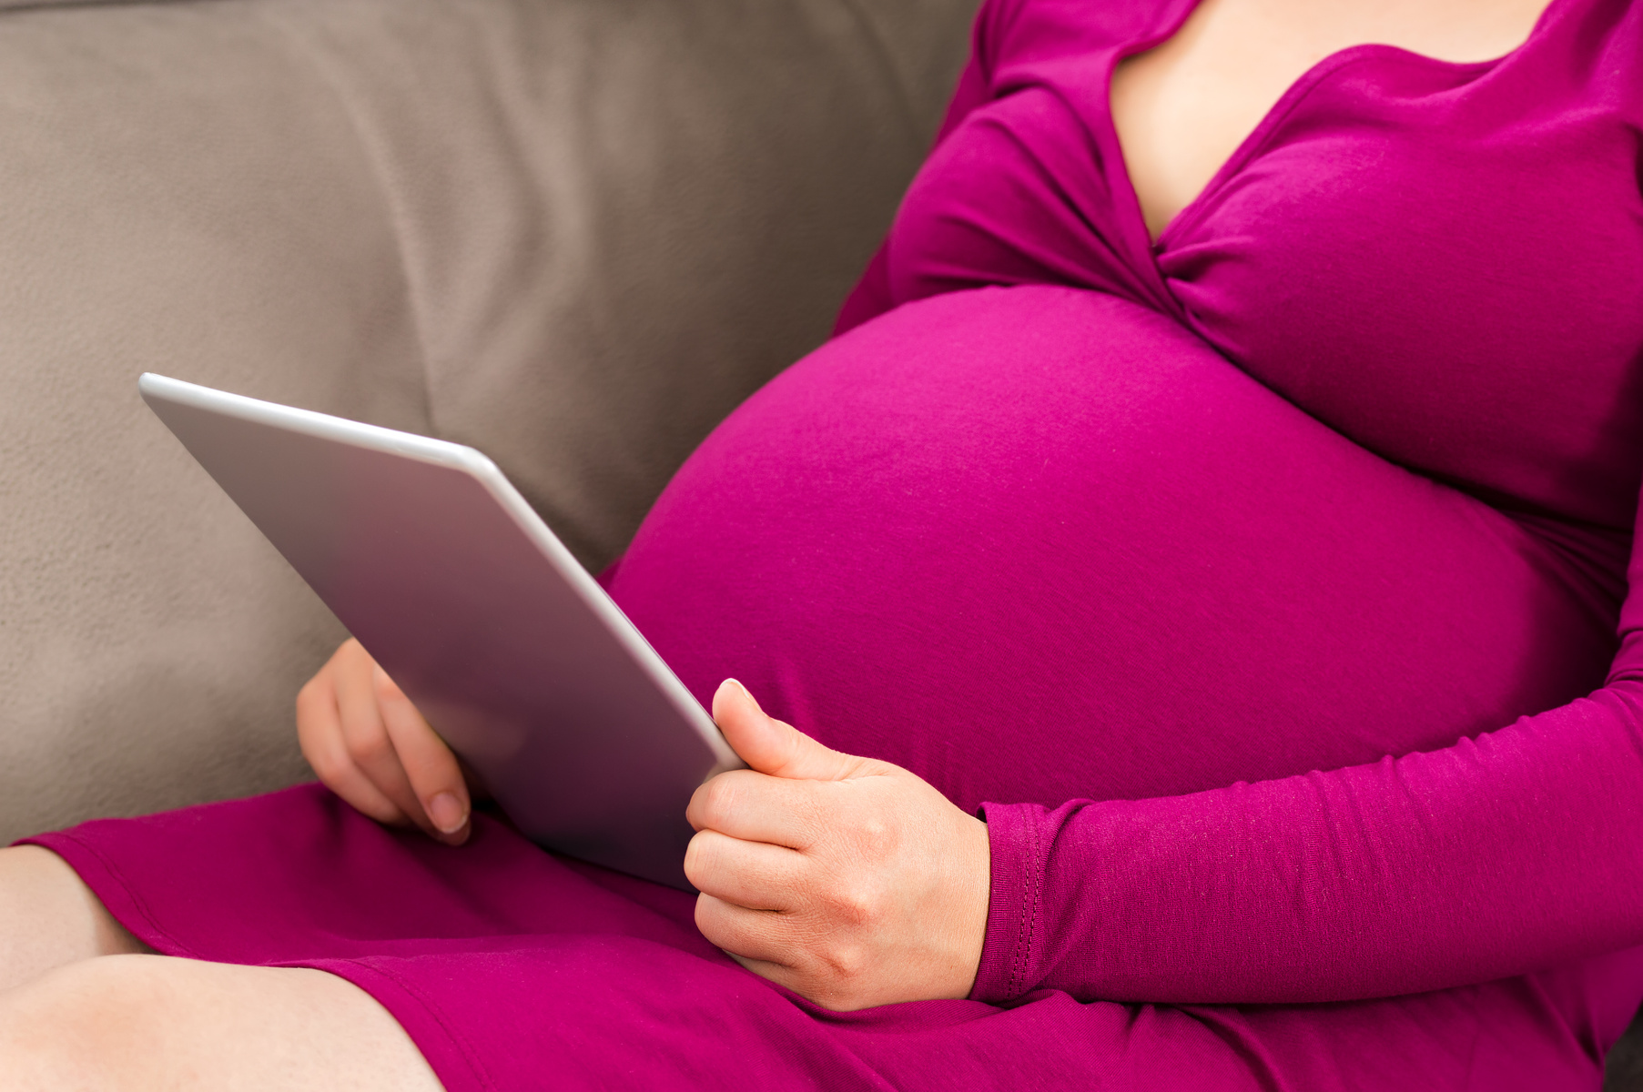

Conclusion of Antenatal Diet
A well-balanced antenatal diet ensures a healthy pregnancy, smooth delivery, and a strong foundation for the baby’s health.
Avoid processed foods, excessive sugar, and alcohol while focusing on nutrient-dense meals.
Consult an expert like Dt. Ria Hawle for a personalized antenatal diet plan tailored to your needs.

Slide 13
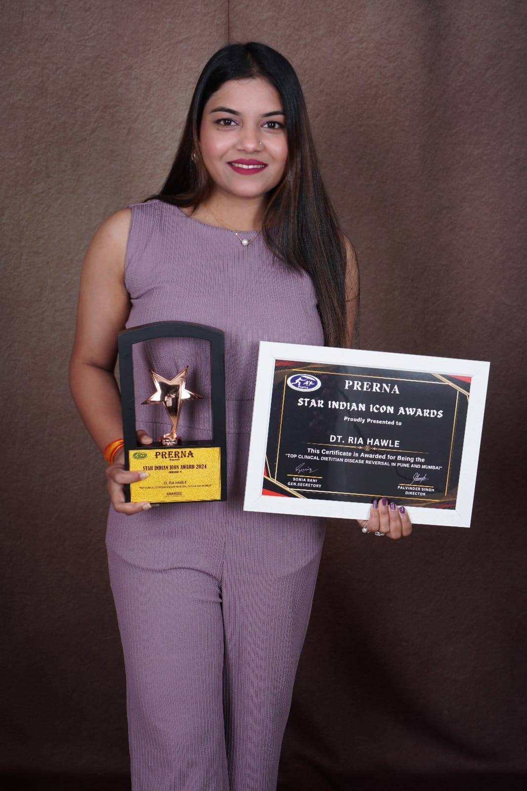



About Balanced Bowls, Pune
by Best Dietitian in Pune - Dt. Ria Hawle
Balanced Bowls Pune offers nutrient-rich, wholesome meal plans curated for a healthy and balanced lifestyle.
Our meals focus on fresh, high-quality ingredients, ensuring optimal nutrition for weight management, fitness goals, and overall well-being.
Perfect for those seeking delicious yet healthy eating options in Pune
+91-8208307124
https://balancedbowls.in
riabalancedbowls@gmail.com

